Slide 1
<<<<<
We are
H
e
l
l
o
GROUP 2
>>>>>

Slide 2





WE-ARE-YOUNG
GROUP 02
01
NT132.N11.ATCL
02
ZABBIX
PRESENTATION
CONTENT
PRESENTATION CONTENT
MEMBERS
~ UwU ~

Slide 3





WE-ARE-YOUNG
GROUP 02
01
NT132.N11.ATCL
HỌ VÀ TÊN (1)
02
Mã sinh viên (1)
HOANG VAN ANH DUC
NguyEN DINH KHA
NguyEN THAI DUONG
MEMBERS
PRESENTATION CONTENT
MEMBERS
~ UwU ~

Slide 4
PROJECT: Zabbix
I. Introduction:
1.1. Overview.
1.2. Components.
1.3. Operation.
II. Implementation:
2.1. Topology.
2.2. Set up Server.
III. Demo

Slide 5

I. Introduction:
1.1. Overview
1.1.1. Definition of Zabbix and what it monitors
1.2. Components
1.2.1 Zabbix’s Components
1.3. Operation

Slide 6


OVERVIEW

Slide 7

ZABBIX FOR MONITORING
Zabbix is an open-source monitoring tool

Slide 8


Slide 9




NETWORK MONITORING
$$\text{} \text{Network} \text{performance}$$
$$\text{} \text{Network} \text{health}$$
$$\text{} \text{Configuration} \text{changes}$$
Notes:
http://www.color-hex.com/color-palette/41134

Slide 10



NETWORK MONITORING
$$\text{} \text{Network} \text{performance}$$
$$\text{} \text{Network} \text{health}$$
$$\text{} \text{Configuration} \text{changes}$$
Network bandwidth usage
Packet loss rate
Interface error rate
High CPU or memory utilization
Number of tcp connections is anomaly high for this day of the week
- Aggregate throughput of core routers is low
- Link is down
- System status is in warning/critical state
- Device temperature is too high / too low
- Power supply is in critical state
- Free disk space is low
- Fan is in critical state
- No SNMP data collection
New device added or removed
Network module is added, removed or replaced
Firmware has been upgraded
Device serial number has changed
- Interface has changed to lower speed or half-duplex mode
Notes:
http://www.color-hex.com/color-palette/41134

Slide 11



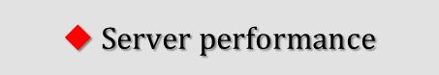

SERVER MONITORING
$$\text{} \text{Server} \text{availability}$$
$$\text{} \text{Server} \text{performance}$$
$$\text{} \text{Configuration} \text{changes}$$
High CPU or memory utilization
Network bandwidth usage
Packet loss rate
Interface error rate
Number of tcp connections is anomaly high for this day of the week
Aggregate throughput of core routers is low
- Free disk space is low
- System status is in warning/critical state
- Device temperature is too high / too low
- Power supply is in critical state
- Fan is in critical state
- No SNMP data collection
- Network connection is down
- New components added or removed
- Network module is added, removed or replaced
- Firmware has been upgraded
- Device serial number has changed
- Interface has changed to lower speed or half-duplex mode

Slide 12
Cloud monitoring: Google Apps, Amazon Web Service (AWS), Google Cloud, …
Application monitoring: Gitlab, Microsoft IIS, …
Service monitoring: HTTP, HTTPS, Active Directory, Nginx, …

Slide 13
How does Zabbix monitor ?
۞ Zabbix Agent: It is deployed on the endpoint to monitor the local resources and applications. Information gathered by the agent forwarded to the Zabbix server for further processing.
۞ SNMP Agent: Any device which supports SNMP can be configured to report back to Zabbix on the basis of configured templates.
JMX Monitoring: This is used to monitor JMS counters of a Java application.
۞ IPMI Checks: This allows Zabbix to monitor the health and availability of the Intelligent Platform Management Interface (IPMI) devices.

Slide 14

COMPONENTS:

Slide 15
ZABBIX Server
• The Server can remotely check networked services.
• The central component: the Agents will report availability and integrity information and statistics.
ZABBIX Agent
• In order to active monitor, those systems must run the Zabbix Agent.
• The Agent will gather information from the system and then report these data to the Server
Web Interface
• In order to allow easy access to the monitoring data and the configuration of Zabbix from anywhere and from any platform, the Web-based Interface is provided.

Slide 16
What data to retrieve through monitoring?
Now we know that Zabbix will use Zabbix Agent, SNMP, JMS, and IPMI checks. However, how will these monitoring techniques know what data to retrieve ?
This will be dictated by templates. When you add a host in Zabbix to monitor, then you assign a templated to that host. Template dictates what type of data it would like Zabbix agent, SNMP, JMS, or IPMI checks have to send back to Zabbix.

Slide 17

Three discovery mode options:
Network discovery
Low-level discovery
Auto-discovery
OPERATION:
01
Polling:
Passive checks (polling):
Zabbix server requests a value from Zabbix agent.
Agent processes the request and returns the value to Zabbix server
Trapping:
Active checks (trapping):
Zabbix agent requests from Zabbix server a list of active checks.
Agent sends the results in periodically.
02
03
ZABBIX

Slide 18


Request Used memory
Passive mode
Response: 6 Gb
Request list to check
Active mode
Response(memory,…)
CPU: 3.5
Memory: 6 Gb

Slide 19
IMPLEMENTATION
TOPOLOGY

Slide 20

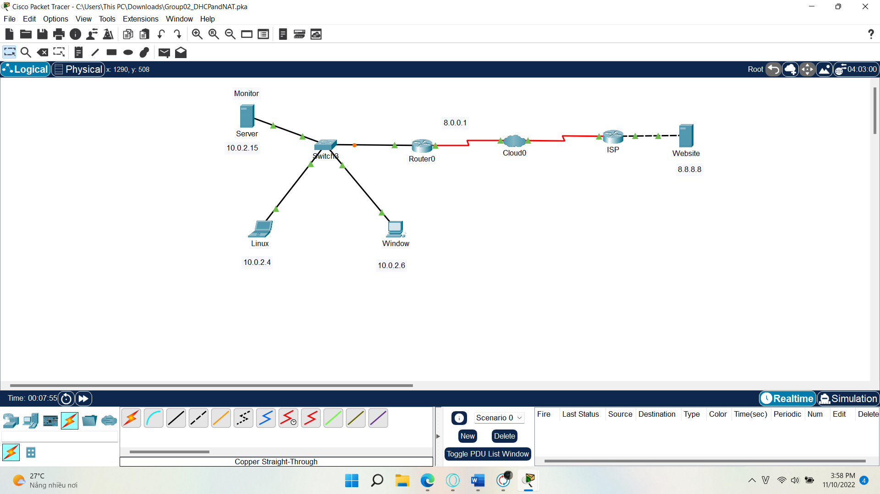
Topology

Slide 21
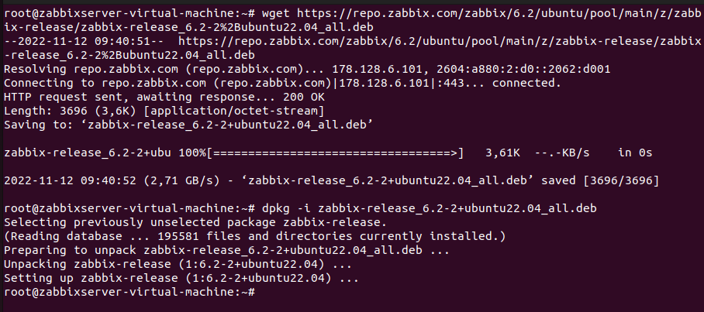

Slide 22
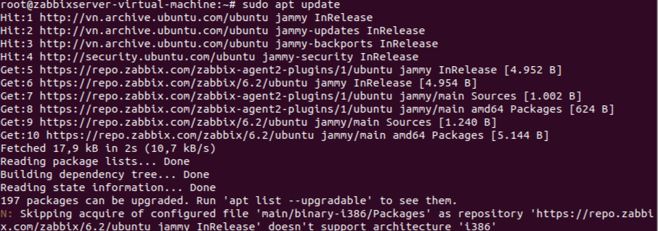

Slide 24

Zabbix Monitoring
Demo

Slide 25
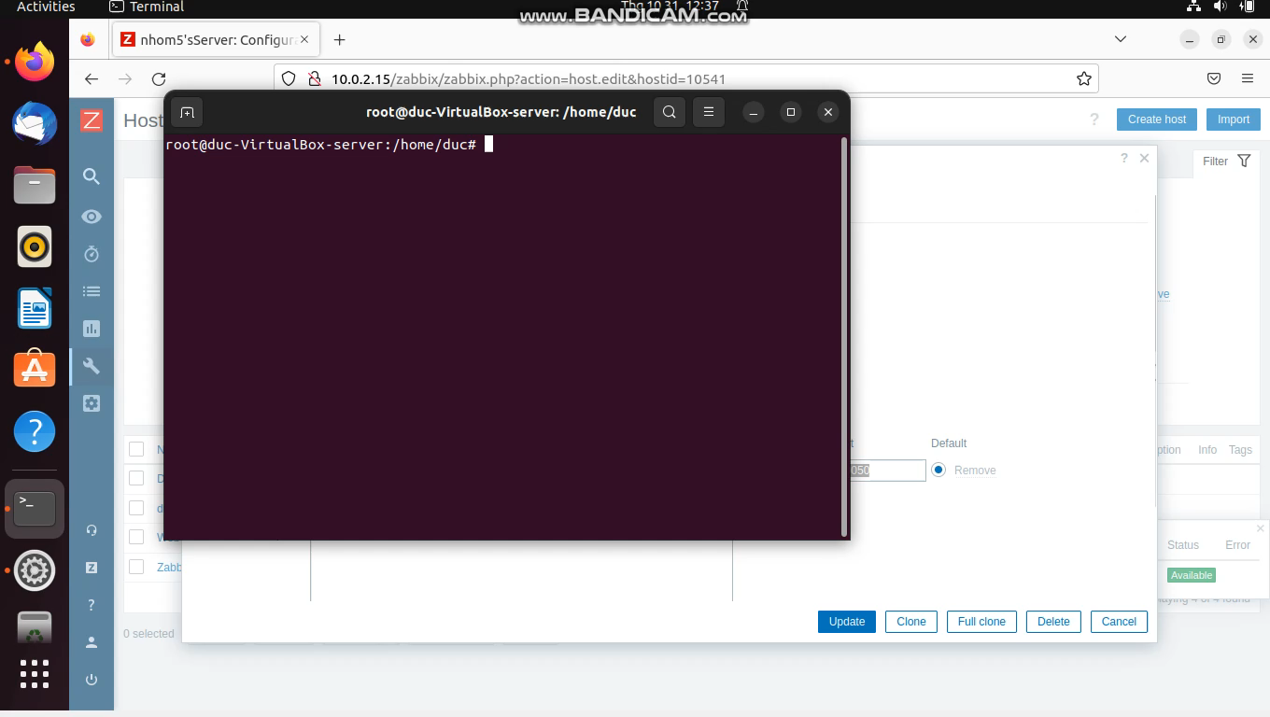
Demo part 1

Slide 26
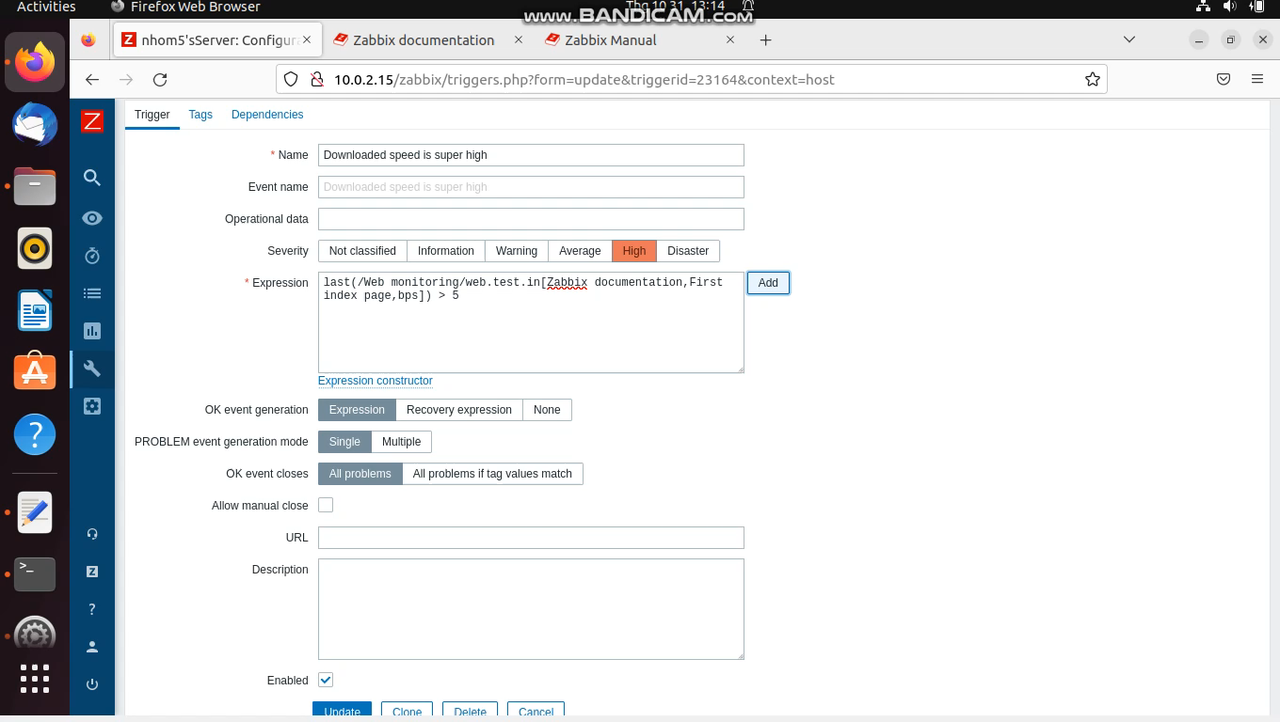
Demo part 2

Slide 27

THANKS FOR WATHCHING !

